Slide 1
CURBING THE OPIOID EPIDEMIC:
DRUG DECRIMINALIZATION AS A SOCIAL JUSTICE INITIATIVE
HSRV311: SOCIAL JUSTICE IN ACTION
A social justice project produced and presented
BY TAYLOR MUECK
September 6th, 2023

Slide 2
WHY THIS SOCIAL JUSTICE PROJECT IS IMPORTANT
As a frontline worker within the harm reduction field, I am constantly reminded of the realities and harshness of the opioid epidemic. I work as an Addiction Support Worker for a local non-profit harm reduction-based organization called Calgary Alpha House Society, which is largely known for its downtown intox-homeless shelter and detox facility. As an advocate and frontline shelter worker, I often bear witness to the cracks in the system, social injustices that marginalized and vulnerable populations face, as well as systemic issues that exist within the human services field that directly impact those who live with addictions. As such, I have created this social justice project proposal surrounding drug criminalization, with intentions of shedding light on the harsh realities of the opioid epidemic while proposing, what I believe is the most appropriate and effective course of action, in overcoming the opioid and overdose crisis.
Enjoy!

Slide 3
CURBING THE OPIOID EPIDEMIC: DRUG DECRIMINALIZATION AS A SOCIAL JUSTICE INITIATIVE
INTRODUCTION: CURBING THE OPIOID EPIDEMIC
Background information and statistics
Current prevention strategies and approaches
THE LINK
Contributing Factors and Negative Influences
THE ISSUE
Negative Outcomes, contributing factors,
and the cycle of addiction
Overdose crisis; signs and symptoms of an overdose
THE PROJECT
Addressing the Issue(s)
THE OUTCOME
Social Justice with a Two-Eyed Seeing Perspective
TWO-EYED SEEING LENS & DRUG DECRIMINALIZATION
Finding a successful solution
SUMMARY
Drug decriminalization, drug testing, and hands on harm reduction practices: why it works

Slide 4
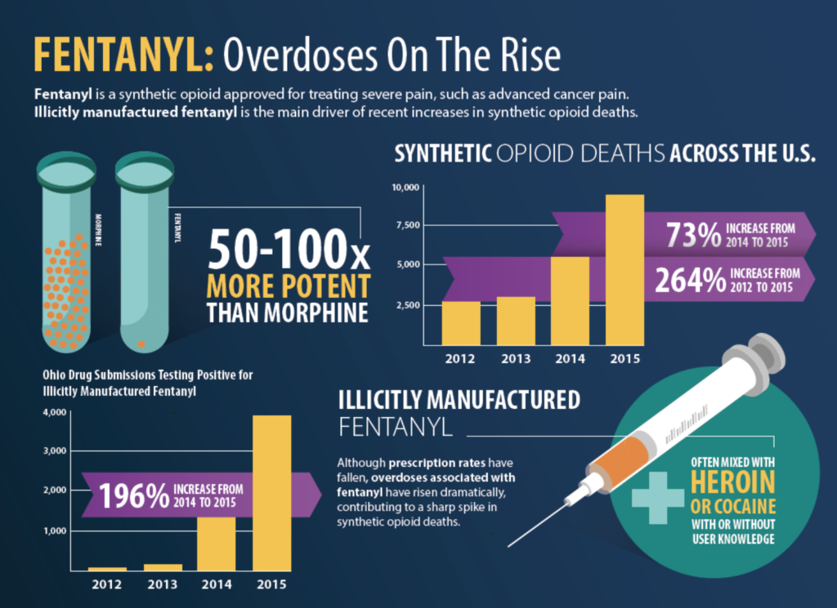
INTRODUCTION: CURBING THE OPIOID EPIDEMIC
Opioids are pain-relieving substances that include synthetic and semisynthetic compounds that interact with opioid receptors within the brain, this includes both pharmaceutical (prescribed medical grade drugs) and non-pharmaceutical (illicit street drugs) (Hatt, 2022, 6 January).
Despite being an effective source of pain management, opioids come with long-term, adverse side effects and health outcomes such as liver damage, increased physical pain and discomfort, withdrawal symptoms, increased tolerance and dependency, and in severe cases overdose resulting in death (Hatt, 2022, 6 January).
Photo retrieved from: fentanyl - Bing images

Slide 5
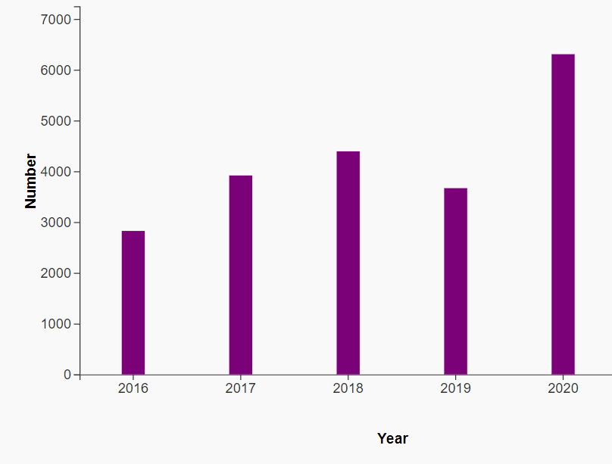
INTRODUCTION: CURBING THE OPIOID EPIDEMIC
Figure 1 – Annual Total of Apparent Opioid Toxicity Deaths in Canada, 2016–2020
Hatt (2022, January 6) states that between January 2016 and March 2021 over 22,000 Canadians have succumbed to the results of opioid toxicity.
In 2020 85 percent of opioid related deaths took place in Alberta, British Columbia, and Ontario (Hatt, 2022, January 6).
The Government of Canada (2021, July 20) states that medical grade opioids are also a contributing factor – the over prescribing of opioids increases exposure and risks.
Source: Government of Canada, “Graphs: Number of total apparent opioid toxicity deaths in Canada, 2016 to 2021 (Jan to Mar),” Opioid‑ and Stimulant‑related Harms in Canada (September 2021), Public Health Infobase, Database, accessed 19 October 2021.
Graph retrieved from: The Opioid Crisis in Canada (parl.ca)

Slide 6
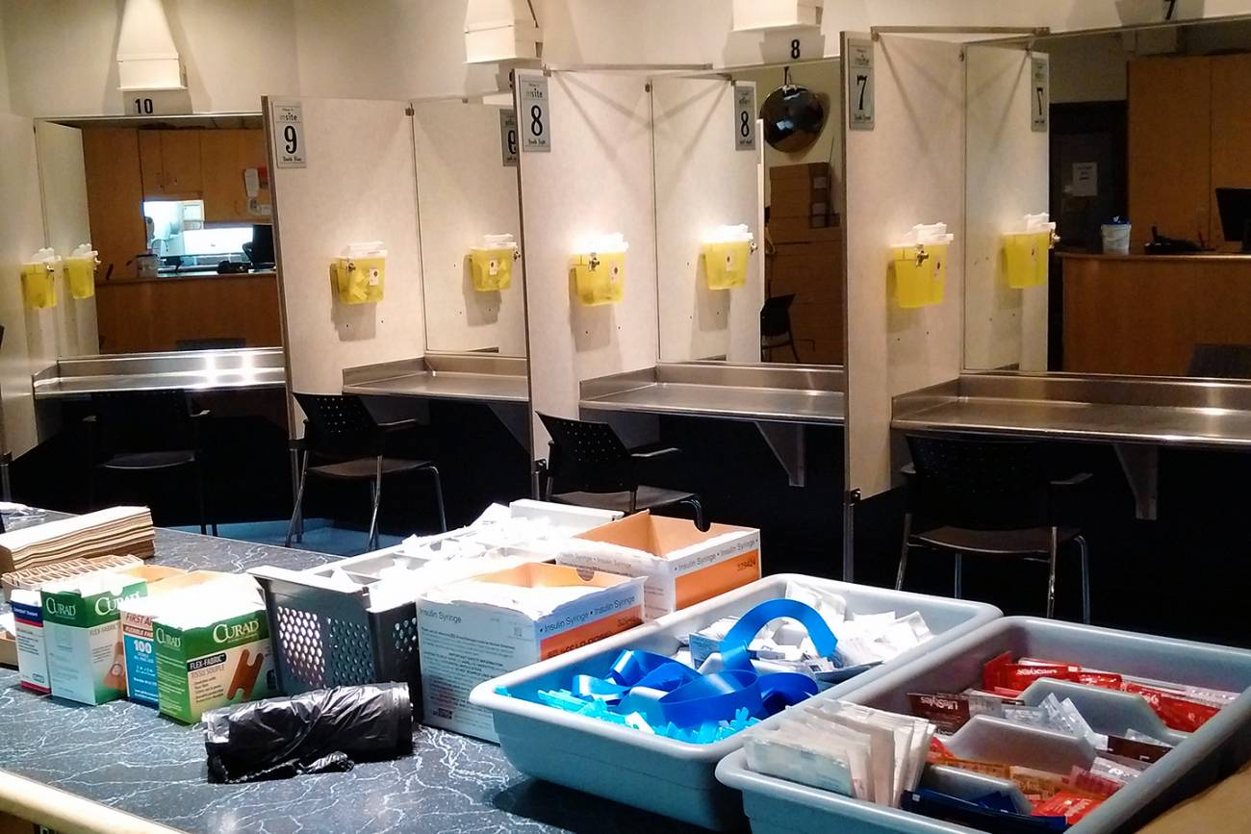
INTRODUCTION: CURBING THE OPIOID EPIDEMIC
Current prevention strategies and approaches to overcome the Opioid crisis:
Naloxone or Narcan, which is available in the form of injection and nasal spray are available for free at any pharmacy (Government of Canada, 2021, July 20).
Supervised Consumption Sites (SCS) provide a clean and safe environment for people to use opioids in the presence of trained staff; the intentions of SCS’s and trained staff are to prevent accidental overdoses and deaths, as well as reduce the spread of diseases such as HIV (Government of Canada, 2021, July 20).
Drug checking allows individuals to have their substances checked for impurities and cross contamination of other substances such as fentanyl; AAWEAR, an Alberta based peer support advocacy organization has implemented a mobile drug checking unit with the help of an 18-month grant from Health Canada (Riebe, 2020 August 25).
Photo retrieved from: supervised consumption sites calgary - Bing images
Photo retrieved from: Edmonton considering drug checking program to prevent overdoses | CBC News

Slide 7
THE LINK
Contributing factors and Negative influences
Multi-system failure to regulate the production and distribution of opioids
Care, treatment, social services, knowledge within mainstream medicine and the connection, or lack there of, between all aspects and sources; inaccessibility and lack of knowledge for those who use substances
Stigma surrounding addiction, substance use, and mental illness
A lack of substance use and addiction training within mainstream medicine and health care professions
A grey area existing between incarceration because of substance use as opposed to treatment and support
Lack of prevention strategies and approaches
- Feldscher, K. (2022, February 9).
7

Slide 8
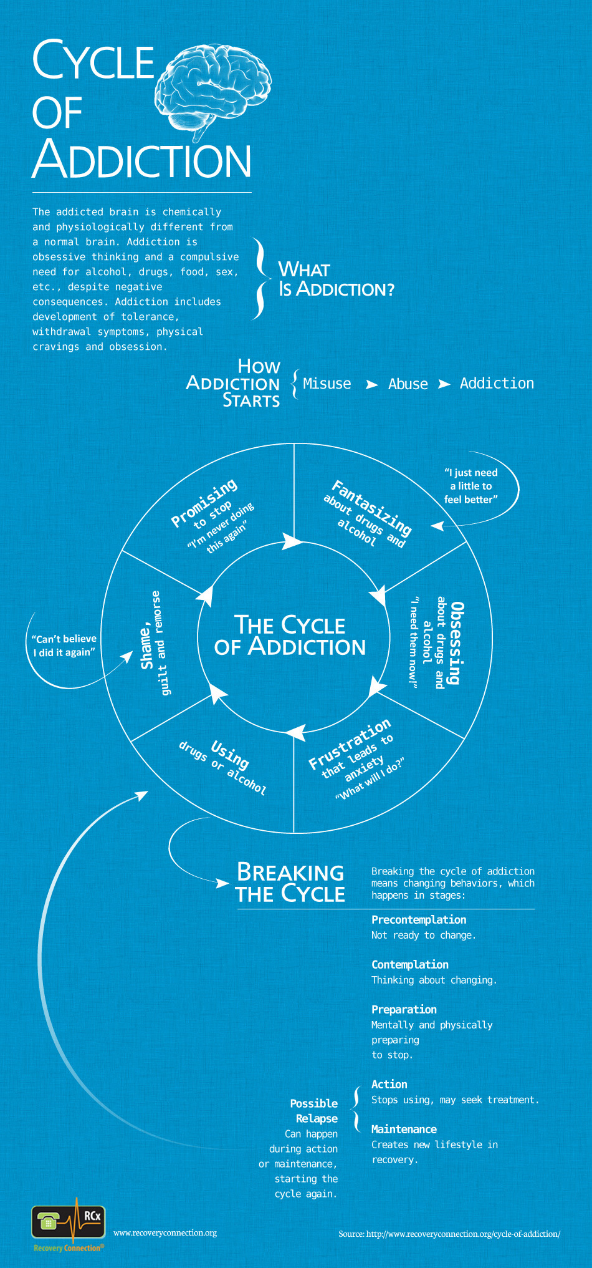
THE ISSUE
Image retrieved from: cycle of addiction - Bing images
Negative outcomes and side effects:
Short-term side effects include but are not limited to confusion, constipation, dizziness and drowsiness, nausea, vomiting, unintentional overdose
Long-term side effects include but are not limited to adrenal insufficiency, sleep apnea, hypogonadism, osteoporosis, tremors, gastroesophageal reflux disease (GERD), opioid-induced hyperalgesia (OIH), unintentional overdose, suppressing of the immune system which increases the chances of infection(s), and death.
Tolerance and dependence, withdrawal symptoms, opioid use disorder, and addiction.
- Nall and Morrell (2023, July 28).
Contributing factors:
Contributing factors or the causes of addiction vary significantly; there is not one single theory, reason, or contributor that explains why people become addicted to substances such as fentanyl
Early life experiences, trauma, parenting styles, neglectful parenting, exposure to violence, divorce, unstable living situations, poverty, homelessness, peer pressure, mental illnesses or poor mental health (i.e.. Depression, anxiety, stress) are some of the most common life circumstances and contributing factors to addiction.
- Psychology Today (n.d.).

Slide 9
THE ISSUE
Image retrieved from: cycle of addiction - Bing images
Regression in harm reduction practices within Canada: structural regression and ideologically driven regression
Changes in social services and human services practices over the past couple decades have proven that structural regression and systemic issues are greatly affecting the practices of harm reduction and curbing the opioid epidemic
Harm reduction practices are becoming more “system” driven which ultimately enforces social control and societal integration, rather than promoting what harm reduction stands for – social welfare, respecting individual human needs, inclusion, compassion, empathy, responding to societal changes, and meeting individuals where they are at.
- Cavalieri and Riley (2012).
The criminal justice system is used to combat substance use currently, which is seen as highly ineffective.
Using the legal/criminal justice system to overcome the opioid epidemic produces the image that substance use, and addiction are an enforcement issue, rather than a public health issue.
- MacQuarrie and Brunelle (2021, October 9).
Aggressive policing practices are said to be associated with increased risks of drug use including overdoses
Harsher penalties (legal/criminal repercussions) ultimately create fewer effective deterrents on drug use, which in turn create more harm to drug users
- Unlu, Tammi, and Hakkarainen (2020, September).

Slide 10
THE ISSUE
Image retrieved from: overdose - Bing images
Signs and symptoms of an overdose:
Blue/gray fingertips, lips, and/or skin
Dozing (nodding) off, despite trying to stay awake
Pale/ashen, clammy, and cold skin
Small/constricted pupils; pin sized pupils
slowed, and/or erratic heart
Slowed, ragged, irregular breathing; not breathing at all
- Nall and Morrell (2023, July 28).
Over the past 20 years, harm reduction interventions have become more mainstream within Canada, but it is not enough
Criminalization of those who use drugs has a direct impact on other forms of social and political harms such as poverty, housing instability, and stigma
The power struggle between the state (government bodies) and grassroots organizations (non-profit harm reduction organizations such as Alpha House Society) continues to negatively impact current initiatives and harm reduction approaches
- Nowell and Masuda (2020).

Slide 11
THE PROJECT
Addressing the issue(s), drug testing, and drug decriminalization
Implementing harm reduction practices with stronger foundations, values, and morals that are embedded in the grassroots - of both the concept and the organizations themselves – and are centered around the individuals rather than the system.
Building upon current harm reduction strategies, approaches, and practices that are already in place; enhancing current initiatives
Branching out on drug testing initiatives and moving from temporary to permanent implementation
Moving closer towards drug decriminalization in attempt to not only curb the ongoing overdose crises, but also curbing all the related subsequent consequences of such (housing insecurities, poverty, homelessness, stigma, and mental illness, etc.).
ADVOCACY, ADVOCACY, ADVOCACY!!!
In 2020 the Canadian Association of Chiefs of Police (CACP) stated in a report that Canadas current criminal justice system is deemed ineffective when it comes to overcoming the use of illicit substances; decriminalization of illicit substances is seen as an appropriate alternative that identifies substance use as a public health crisis as opposed to being an enforcement or criminal issue. – MacQuarrie and Brunelle (2021, October 9).
Decriminalization is typically utilized to reduce public health concerns and risks, fatal overdoses, and costs of prohibition laws; decriminalization laws must be outlined clearly and impacts of policy should be interpreted more cautiously as the complexities regarding drug policy affect society on a profoundly multifaceted level. – Unlu, Tammi, and Hakkarainen (2020).

Slide 12
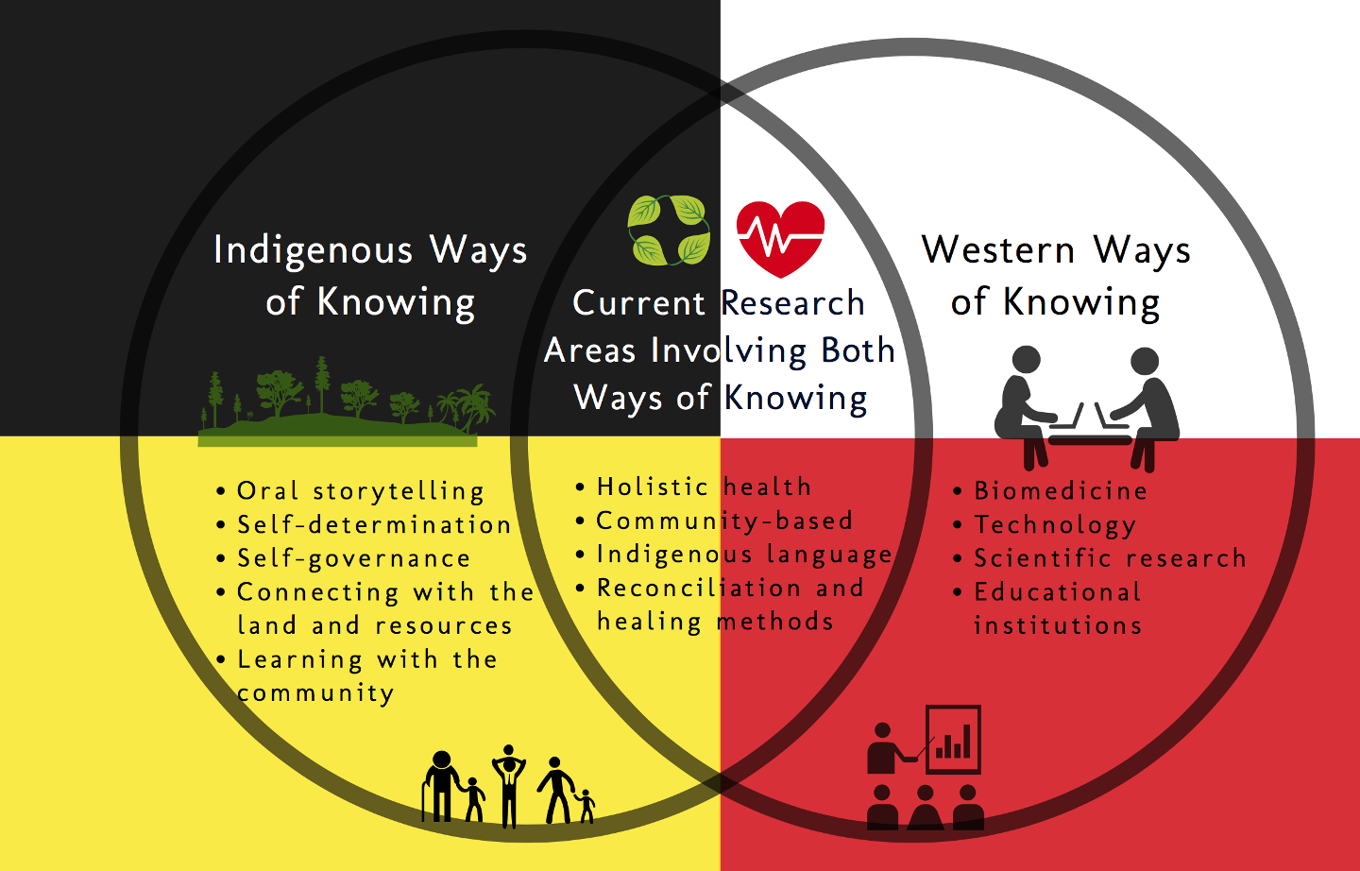
THE PROJECT
Image retrieved from: two eyed seeing approach to addiction - Bing images
The goal is to shift current drug policies and harm reduction practices from a systematic and criminal/legal perspective (western ways of knowing) to a more health based and interconnected/holistic (Indigenous ways of knowing) perspective. However, the integration of appropriate knowledge from both perspectives, to create and establish a drug decriminalization and harm reduction action plan that encompasses the full Etuaptmumk (two-eyed seeing) perspective of intervention is critical in establishing and implementing long lasting and effective strategies, approaches, interventions, and meaningful outcomes.
The use of a health focused framework regarding the opioid epidemic, rather than a legal or criminal justice focused framework will produce better outcomes in the long run. – Unlu, Tammi, and Hakkarainen (2020).

Slide 13
THE OUTCOME(S)
From an individual level, social injustices will gradually be reduced and eventually be eliminated.
A shift in paradigm as an essential step in policy design (Unlu, Tammi, and Hakkarainen, 2020) which would ultimately prove to be more effective than current approaches and policies.
Reframing the common misconception that drug use is a criminal justice or legal issue rather than a health issue or social issue.
A reduction in fatal overdoses, societal stigma surrounding drug use, and an overall positive impact on the opioid crisis.
The ability to fight and overcome subsequent consequences and underlying contributors to the opioid crisis; fighting housing insecurities, poverty, mental illness, etc.
Producing more accessible supports and services to individuals such as treatment, intervention, health care, social services, and rehabilitation.
Removing barriers and criminal/legal implications of drug use; lessening the stigma surrounding addiction.
The introduction and effective use of Etuaptmumk (two-eyed seeing) perspective
Image retrieved from: what is the two eyed seeing approach - Bing images

Slide 14
TWO-EYED SEEING LENS & DRUG DECRIMINALIZATION
The ability to overcome the opioid epidemic comes from the willingness, strength, and knowledge as a society. Using a “clear-eyed” perspective regarding what is currently working, what isn’t currently working, and where existing gaps are.
- Murthy (2016, December 22).
“Two-eyed seeing is a decolonizing methodology that blends Aboriginal and Western research methods, knowledge translation, and program development”
– Marsh, Marsh, and Najavits (2020, November).
Image retrieved from: two eyed seeing approach to addiction - Bing images

Slide 15
TWO-EYED SEEING LENS & DRUG DECRIMINALIZATION
“In contrast, decriminalization policies posit drug use as a public health issue rather than as a legal one”
– MacQuarrie and Brunelle (2021, October 9).
“Access to harm reduction services is both a health right and a human right”
- Cavalieri and Riley (2012).
The use of the Two-Eyed seeing lens may allow society to view drug decriminalization as an appropriate approach to overcoming the opioid crisis. The Two-Eyed seeing approach would allow policy makers, medical professionals, government officials, front line workers, harm reduction activists, and those who use drugs to integrate both western medicine and holistic perspectives of Indigenous knowledge into one effective approach (drug decriminalization, drug checking, increased and enhanced harm reduction strategies, etc.).
Marsh, Marsh, and Najavits (2020, November), state in the conclusion of their research study that the use of the Two-eyed seeing perspective in relation to drug use [and intergenerational trauma] and treatment approaches , was seen as having profoundly empowering and significantly transformative experiences on a spiritual, emotional, and physical level. the expected growth, intervention, and abilities to overcome such difficult and multifaceted social issues that is associated with the Two-eyed seeing perspective is significant, which is why the proposed project has a direct focus on integrating western medicine/knowledge and indigenous knowledge/teachings to overcome the opioid epidemic. Finding a balance between the two perspectives and incorporating policy changes such as drug decriminalization, drug checking initiatives, and enhanced harm reduction strategies may prove to be more appropriate and effective solutions than what are currently in place.

Slide 16
SUMMARY: WHY IT WORKS
Despite efforts and implementation of harm reduction practices over the years, current practices and procedures are visibly ineffective. Supporting sources, statistics, and scholarly references insist that drug decriminalization is the most effective and appropriate solution to curbing the opioid epidemic and overdose crisis that is associated with such. Some of which, also support the notion that a Two-eyed seeing perspective is the most useful approach, in junction with drug decriminalization, to overcome the ineffectiveness of current initiatives and strategies used to overcome the ongoing opioid crisis.
Reframing the work of harm reduction, which was once holistically centered and seen from a two-eyed seeing perspective, as well as integrating drug decriminalization through a social health framework and person centered/trauma informed perspective, is essential to overcoming the existing cracks in the system and fighting the overdose crisis. Furthermore, the implementation, continuation and progressiveness of approaches such as drug checking, trauma informed/person centered care, and drug decriminalization are critical in overcoming such an increasingly dangerous social crisis.
Despite the complexities that are associated with the ongoing opioid epidemic, with great determination, advocacy efforts, changes in perspective, and hunger for knowledge and acceptance advocates, policy makers, medical professionals, front line workers, government officials, and all those alike can enforce the urgency, appropriateness, and effectiveness that is imbedded in drug decriminalization and the associated practices and procedures.
The proposed social issue project of drug decriminalization implementation will work as it is already evident that harm reduction saves lives, thus works. However, with enhancement, revision, and advancement in harm reduction practices and procedures, even more lives will be saved moving forward.
TOGETHER WE CAN CURB THE OPIOID CRISIS.
“When the prohibition approach is recognized as the source of uncontrollable social problems, decriminalization becomes a valid government response” – Unlu, Tammi, and Hakkarainen (2020, September).

